Slide 1


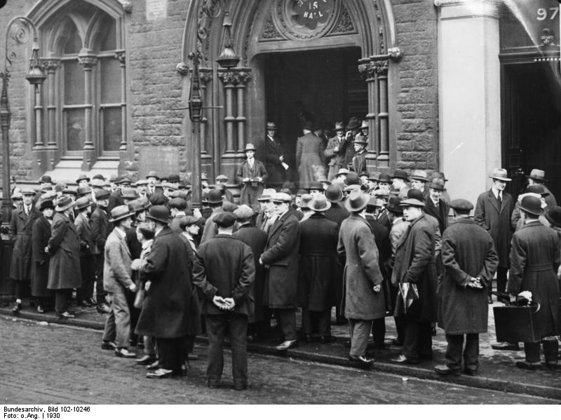
Today, we will be looking at Britain in the 1930s.
Learning aims
To predict learning
To categorise changes
To explain changes

Slide 2
The 1930s
Things you know that might have an impact.
Questions you want answered.
Before | During

Slide 3
Looking at the information.
What kind of questions could you create?

Slide 4
Notes:
Deeper questioning and anticipated deeper response is developed from top left to bottom right.
Get pupils to come up with their own questions by choosing a word from the left-most column followed by a word from the top row.
Eg.
What Is… the time / the name of… etc
When Will… the reaction stop if I use X grams of Y?
How Might… we use photosynthesis to overcome the impact of burning fossil fuels?
ActiveX stuff and design by Jon Haines @mr_haines
Inspired by and thanks to @johnsayers

Slide 5
The general level of difficulty of question increases… A “What is?” question is normally easier to create and answer than a “How might?” question.
Notes:
Deeper questioning and anticipated deeper response is developed from top left to bottom right.
Get pupils to come up with their own questions by choosing a word from the left-most column followed by a word from the top row.
Eg.
What Is… the time / the name of… etc
When Will… the reaction stop if I use X grams of Y?
How Might… we use photosynthesis to overcome the impact of burning fossil fuels?
ActiveX stuff and design by Jon Haines @mr_haines
Inspired by and thanks to @johnsayers

Slide 6
How did Britain change in the 1930s?
Exam Time limit 30mins
Plan an answer, think about the skills you will need.
The limits.
The information needed.

Slide 7
Swap Over
WWW (what went well)
EBI (even better if)

Slide 8


Slide 9
Acknowledgements
Unemployed people in front of a workhouse in London 1930, Wikipedia Creative Commons

